Slide 1
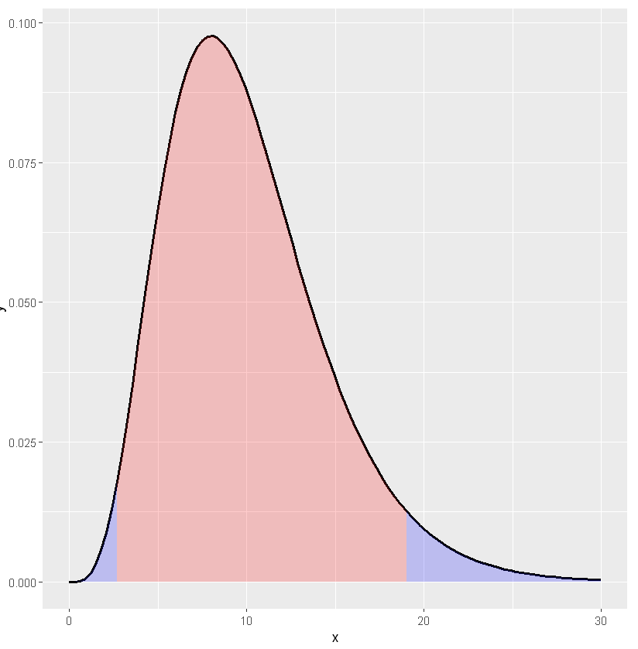
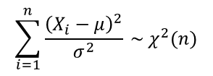
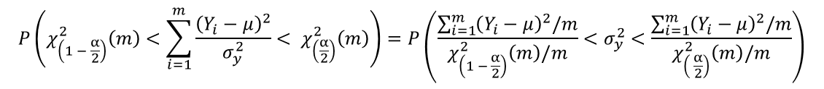
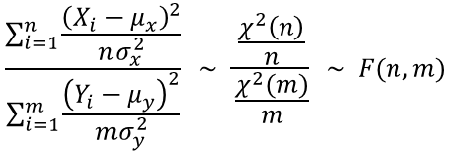

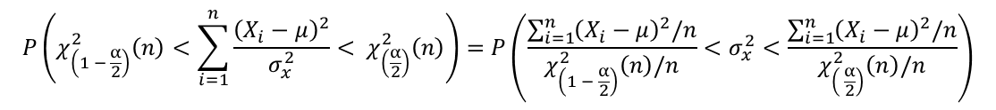

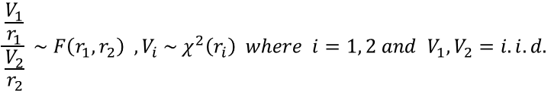

The confidence interval of known the population mean case
$$\sum_{i=1}^{n}{\frac{{\left(X_{i}−μ\right)}^{2}}{σ^{2}} \sim χ^{2}(n)}$$
$$\frac{\frac{V_{1}}{r_{1}}}{\frac{V_{2}}{r_{2}}} \sim F\left(r_{1}, r_{2}\right) , V_{i} \sim { χ}^{2}\left(r_{i}\right) where i=1, 2 and V_{1}, V_{2}=i.i.d.$$
$$\frac{\sum_{i=1}^{n}{\frac{{\left(X_{i}−μ_{x}\right)}^{2}}{nσ_{x}^{2}}}}{\sum_{i=1}^{m}{\frac{{\left(Y_{i}−μ_{y}\right)}^{2}}{mσ_{y}^{2}}}} \sim \frac{\frac{χ^{2}\left(n\right)}{n}}{\frac{χ^{2}(m)}{m}} \sim F(n, m)$$
$$P\left(χ_{\left(1 − \frac{α}{2}\right)}^{2}\left(n\right)<\sum_{i=1}^{n}{\frac{{\left(X_{i}−μ\right)}^{2}}{σ_{x}^{2}}< χ_{\left(\frac{α}{2}\right)}^{2}\left(n\right)}\right)=P\left(\frac{\sum_{i=1}^{n}{{\left(X_{i}−μ\right)}^{2}/n}}{χ_{\left(1 − \frac{α}{2}\right)}^{2}\left(n\right)/n}<σ_{x}^{2}<\frac{\sum_{i=1}^{n}{{\left(X_{i}−μ\right)}^{2}/n}}{χ_{\left( \frac{α}{2}\right)}^{2}\left(n\right)/n}\right)$$
$1 −$ $α$
$$P\left(χ_{\left(1 − \frac{α}{2}\right)}^{2}\left(m\right)<\sum_{i=1}^{m}{\frac{{\left(Y_{i}−μ\right)}^{2}}{σ_{y}^{2}}< χ_{\left(\frac{α}{2}\right)}^{2}\left(m\right)}\right)=P\left(\frac{\sum_{i=1}^{m}{{\left(Y_{i}−μ\right)}^{2}/m}}{χ_{\left(1 − \frac{α}{2}\right)}^{2}\left(m\right)/m}<σ_{y}^{2}<\frac{\sum_{i=1}^{m}{{\left(Y_{i}−μ\right)}^{2}/m}}{χ_{\left( \frac{α}{2}\right)}^{2}\left(m\right)/m}\right)$$
$$\frac{α}{2}$$
$$\frac{α}{2}$$
$$P\left(\frac{\sum_{i=1}^{n}{\frac{{\left(X_{i}−μ\right)}^{2}}{n}}}{\sum_{i=1}^{m}{\frac{{\left(Y_{i}−μ\right)}^{2}}{m}}} × \frac{\frac{χ_{\left(1 − \frac{α}{2}\right)}^{2}\left(m\right)}{m}}{\frac{χ_{\left(1 − \frac{α}{2}\right)}^{2}\left(n\right)}{n}}<\frac{σ_{x}^{2}}{σ_{y}^{2}}<\frac{\sum_{i=1}^{n}{\frac{{\left(X_{i}−μ\right)}^{2}}{n}}}{\sum_{i=1}^{m}{\frac{{\left(Y_{i}−μ\right)}^{2}}{m}}}× \frac{\frac{χ_{\left(\frac{α}{2}\right)}^{2}\left(m\right)}{m}}{\frac{χ_{\left(\frac{α}{2}\right)}^{2}\left(n\right)}{n}}\right) \sim P\left(\frac{\sum_{i=1}^{n}{\frac{{\left(X_{i}−μ\right)}^{2}}{n}}}{\sum_{i=1}^{m}{\frac{{\left(Y_{i}−μ\right)}^{2}}{m}}} ×F_{1− \frac{α}{2}} (m, n)<\frac{σ_{x}^{2}}{σ_{y}^{2}}<\frac{\sum_{i=1}^{n}{\frac{{\left(X_{i}−μ\right)}^{2}}{n}}}{\sum_{i=1}^{m}{\frac{{\left(Y_{i}−μ\right)}^{2}}{m}}}×F_{\frac{α}{2}} (m, n)\right)$$

Slide 2
